Slide 1
TRIREX UK Exercise Blyth overview

Slide 2
TRIREX
Triennial Renewables Exercise
No UK national exercise between 2012 and 2022
Intention for a new OREEF supported exercise every three years
Potential for other countries to replicate format in alternate years
2022 – Exercise Sancho

Slide 3
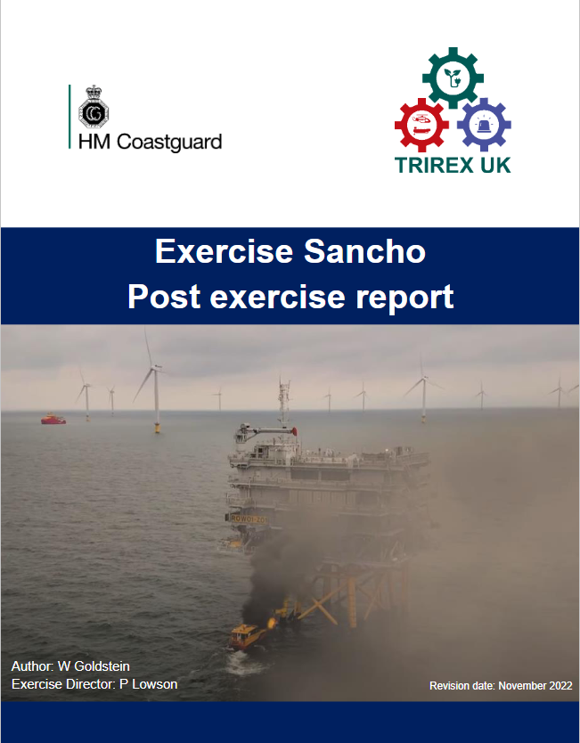
17 Recommendations
44 Observations
20 Good practice
Report and video available on OEER website at www.oeer.uk/oreef

Slide 4
Exercise Blyth
Aim: “To test industry and the emergency service's emergency arrangements and procedures in response to a significant offshore renewables emergency”
17/18 June 2025
Live-play exercise at Moray East Windfarm
Additional tabletop to be held in April. Exercise Albert will test elements of the full exercise and involve additional participants.

Slide 5
Participants
Multi-agency exercise involving regulators, emergency services, search and rescue resources, industry and Government departments.
Collaboration between a variety of organisations
Weather allowing, full offshore participation including industry vessels and UK SAR resources.
Onshore emergency and crisis management, including media response

Slide 6
Observers
Due to multiple locations, physical observer opportunities will be very limited.
However, an MS Teams call will be available from 1000 BST (0900 UTC)
This call will provide an overview of current activities from a variety of locations, all signal reception and workload allowing.
More details contained separately on the OEER website
Join the meeting here

Slide 7
Evaluation
As with Exercise Sancho, Blyth will be subject to a formal evaluation.
The lead evaluator has established an evaluation team for key organisations and teams responding.
This, along with an online feedback form for all participants and observers, will be captured within the exercise report, identifying industry learning and recommendations which will be shared internationally.
The report will be available on the OEER website in September.

Slide 8
Video
The exercise will be recorded at various onshore and offshore locations and a summary video produced.
This will be released via a live premier on YouTube and it is hoped to include a Q&A session.
The video will then be available for use and linked from the OEER website.
The exercise team and OREEF wish to thank Offshore Energies UK for their generous sponsorship for the exercise video.

Slide 9
Sponsorship and support
The exercise team and OREEF want to thank everyone involved in the planning, running, evaluation and support of the exercise. This has all been done from good will and individual organisational time and financial commitment. As well as those from organisations who will be participating, representatives from Vattenfall, MCM, Gibb Medical and Rescue, Restrata, ORE Catapult and RES have all been integral to the planning process.
However, elements of the exercise would not have been possible without the additional sponsorship of Offshore Energies UK (OEUK) and Xceco.
https://oeuk.org.uk/
https://xceco.co.uk/

Slide 10
Additional information and contact
The OEER website will be updated with relevant pertinent information. www.oeer.uk
However, should you require additional detail or wish to be further involved, please use the contacts below as required.
Exercise Director: Pete Lowson, peter.lowson@mcga.gov.uk
Lead Evaluator: Lisa McAuliffe, lisa.mcauliffe@sosrep.gov.uk

